Slide 1
CSE-2103
Object Oriented Programming
Lecture 1 - 1
₂nd
March, 2021

Slide 2
Exception Handling
Lecture 7 - 6
₄th
May, 2021

Slide 3
Exception
When executing C++ code, different errors can occur: coding errors made by the programmer,
errors due to wrong input, or other unforeseeable things.
The technical term for this is: C++ will throw an exception (throw an error).
An exception is an indication of a problem that occurs during a program’s execution.
When you refer to the variable by name in your code, the computer must take two steps:
Ignore them.
Abort processing – detect but don’t try to recover.
Have proper codes to handle error.
Lecture 7 - 7
₄th
May, 2021

Slide 4
Exception
int main()
{
float numerator = 12.5; float denominator = 0; float result;
result = numerator/denominator;
cout << "The quotient of 12.5/0 is "
<< result << endl; return 0;
Program execution will be terminated and
will show an error.
}
Lecture 7 - 8
₄th
May, 2021

Slide 5
Exception
Exception handling in C++ is a mechanism to detect and manage runtime errors (errors that occur during program execution) in a structured way.
Examples of runtime errors are:
Division by zero
Accessing invalid memory
File I/O failures
Lecture 7 - 7
₄th
May, 2021

Slide 6
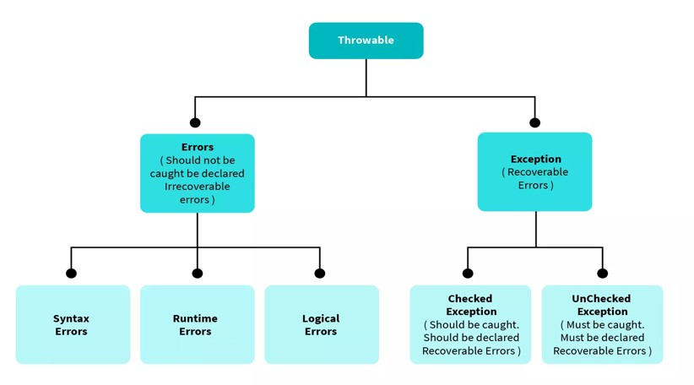
Exception VS ERROR
Lecture 7 - 7
₄th
May, 2021

Slide 7
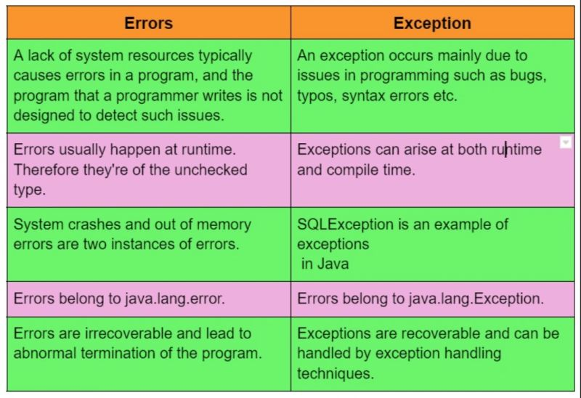
Exception VS ERROR
Lecture 7 - 7
₄th
May, 2021

Slide 8
Exception Handling
Instead of terminating the program abruptly when an error occurs, C++ allows you to throw exceptions and catch them for graceful handling.
How Exception Handling Works in C++
Throwing an Exception: When an error or unexpected situation occurs, the program uses the throw keyword to
signal an exception.
Catching an Exception: The program searches for a matching catch block to intercept and handle the thrown
exception.
Handling the Exception: The catch block contains the logic to respond to the error, allowing the program to
recover or terminate gracefully.
Lecture 7 - 9
₄th
May, 2021

Slide 9
Exception Handling
int main()
{
float numerator = 12.5; float denominator = 0; float result;
try {
if (denominator != 0) {
result = numerator/denominator; cout << "The quotient of 12.5/0 is "
<< result << endl;
} else {
throw (denominator);
}
} catch (float i) {
cout << "Answer is infinite because a-b is:" << i;
}
return 0;
}
Can resolve exceptions:
Allow a program to continue executing or
Notify the user of the problem and
Terminate the program in a controlled
manner
Makes
programs robust and fault-
tolerant.
Lecture 7 - 9
₄th
May, 2021

Slide 10
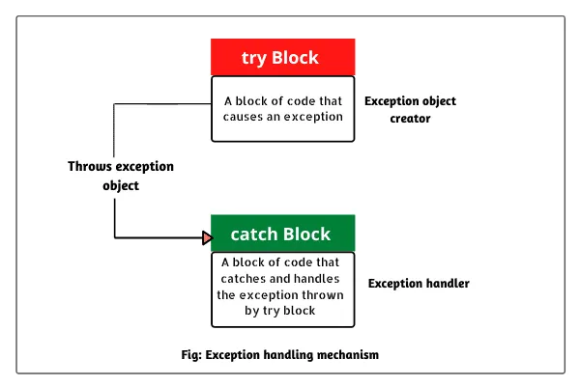
Exception Handling
Lecture 7 - 9
₄th
May, 2021

Slide 11
Exception Handling
int main()
{
float numerator = 12.5; float denominator = 0; float result;
try {
if (denominator != 0) {
result = numerator/denominator; cout << "The quotient of 12.5/0 is "
<< result << endl;
} else {
throw (denominator);
}
} catch (float i) {
cout << "Answer is infinite because a-b is:" << i;
}
return 0;
}
try Blocks:
Keyword try followed by braces ({})
Should enclose
Statements that might cause
exceptions
Statements that should be skipped in case of an exception
Lecture 7 - 10
₄th
May, 2021

Slide 12
Exception Handling
int main()
{
float numerator = 12.5; float denominator = 0; float result;
try {
if (denominator != 0) {
result = numerator/denominator; cout << "The quotient of 12.5/0 is "
<< result << endl;
} else {
throw (denominator);
}
} catch (float i) {
cout << "Answer is infinite because a-b is:" << i;
}
return 0;
}
catch Blocks:
Immediately follow a try block
One or more catch handlers for each
try block
Exception parameter enclosed in parentheses
Represents the type of exception to process
Executes if exception parameter type matches
the exception thrown in the try block
Could be a base class of the thrown exception’s class
Lecture 7 - 11
₄th
May, 2021

Slide 13
Exception Handling
int main()
{
float numerator = 12.5; float denominator = 0; float result;
try {
if (denominator != 0) {
result = numerator/denominator; cout << "The quotient of 12.5/0 is "
<< result << endl;
} else {
throw (denominator);
}
} catch (float i) {
cout << "Answer is infinite because a-b is:" << i;
}
return 0;
}
Throwing an Exception:
Use keyword throw followed by an operand representing the type of exception
The throw operand can be of any type
If the throw operand is an object, it is
called an exception object
The throw operand initializes the exception parameter in the matching catch handler, if one is found
₄th
May, 2021

Slide 14
Exception Handling(Multiple Catch)
try {
// code to try
}
catch (exceptionClass1 &name1) {
// handle exceptions of exceptionClass1
}
catch (exceptionClass2 &name2) {
// handle exceptions of exceptionClass2
}
catch (exceptionClass3 &name3) {
// handle exceptions of exceptionClass3
}
...
/* code to execute if
no exception or
catch handler handled exception*/
₄th
May, 2021

Slide 15
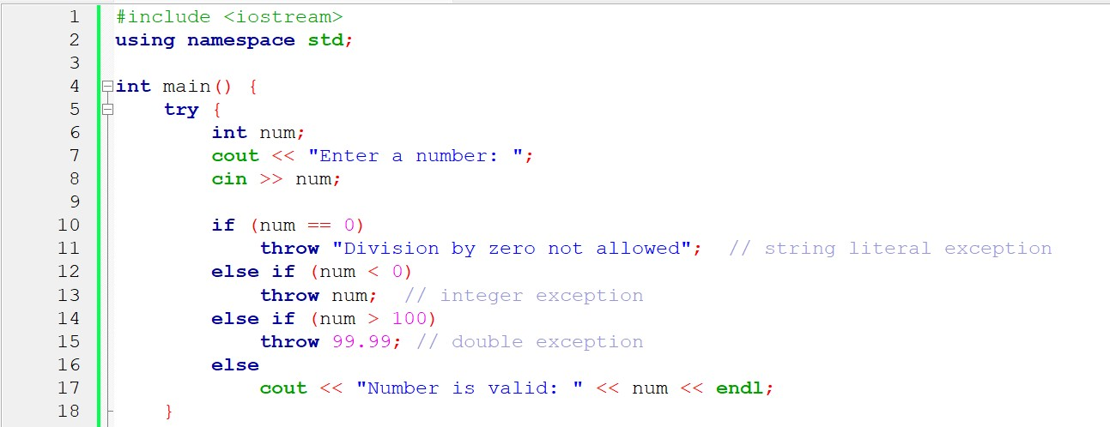
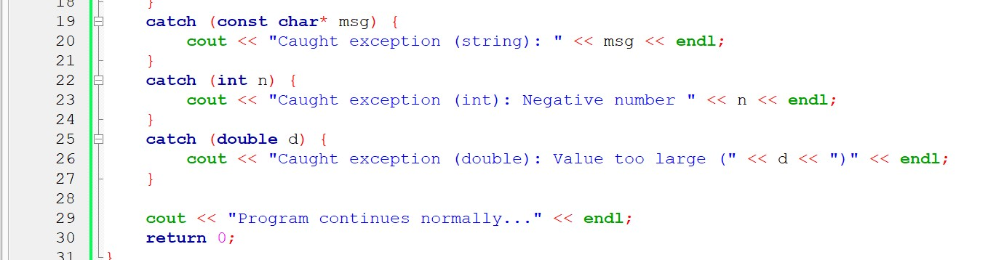
Exception Handling
₄th
May, 2021

Slide 16
Exceptions
- All exceptions generated by the standard library inherit from std::exception
exception
bad_typeid
bad_cast
bad_exception
ios_base::failure
bad_alloc
logic_error
runtime_error
domain_error
range_error
invalid_argument
overflow_error
length_error
underflow_error
out_of_range
₄th
May, 2021

Slide 17
Exceptions
All exceptions generated by the standard library inherit from std::exception
logic_error • runtime_error
invalid_argument
domain_error
length_error
out_of_range
future_error(C++11)
tx_exception(TM TS)
nonexistent_local_time(C++20)
ambiguous_local_time(C++20)
format_error(C++20)
bad_typeid
bad_cast
bad_optional_access(C++17)
runtime_error
bad_any_cast(C++17)
range_error
overflow_error
underflow_error
regex_error(C++11)
system_error(C++11)
filesystem::filesystem_error(C++17)
bad_weak_ptr(C++11)
bad_function_call(C++11)
bad_alloc
bad_array_new_length(C++11)
bad_exception
₄th
May, 2021

Slide 18
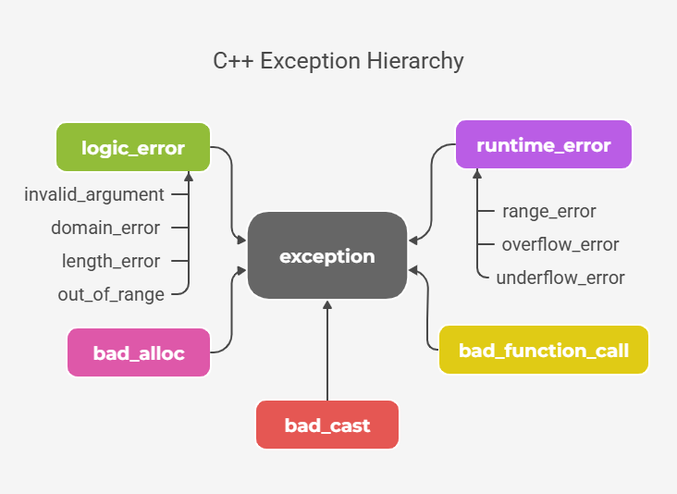
Exceptions

Slide 19
Defining an Exception Class
Because a throw-statement can throw a value of any type, it is common to define a class whose objects can carry the kind of information you want thrown to the catch-block.
A more important reason for a specialized exception class is so you can have a different type to identify each possible kind of exceptional situation.
An exception class is just a class that happens to be used as an exception class
₄th
May, 2021

Slide 20

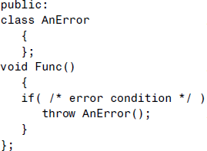
Defining an Exception Class
AClass, which represents any class in which errors might occur.
An exception class, AnError, is specified in the public part of AClass.
In AClass’s member functions we
check for errors. If we find one, we throw an exception, using the keyword throw followed by the constructor for the error class:
₃th
May, 2021

Slide 21
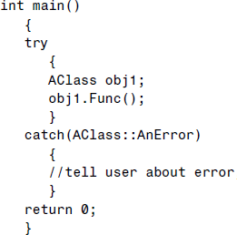
Defining an Exception Class
In the main() part of the program we enclose any statements that interact with AClass in a try-block.
If any of these statements causes an error to be detected in an AClass member function, an exception will be thrown and control will go to the catch block that immediately follows the catch block.
₄th
May, 2021

Slide 22
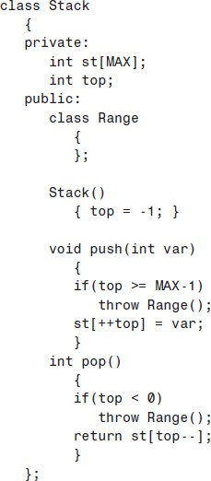
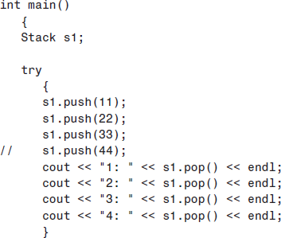
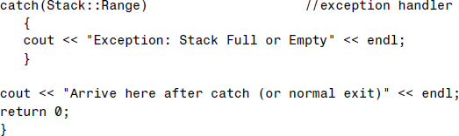
Defining an Exception Class
₄th
May, 2021

Slide 23
CSE-2103
Object Oriented Programming
Lecture 9 - 1
₁st
June, 2021

Slide 24
The Standard Template Library STL
Lecture 9 - 2
₁st
June, 2021

Slide 25

The Standard Template Library
The Standard Template Library (STL), and was developed by Alexander Stepanov and Meng Lee of Hewlett Packard.
The STL is part of the Standard C++ class library, and can be used as a standard approach to storing and processing data.
The STL is a powerful set of C++ template classes that implement many popular and commonly used algorithms and data structures, also provide generic classes and function that can be used to manipulate data.
STL
Container
Algorithms
Iterators
Lecture 9 - 3
₁st
June, 2021

Slide 26
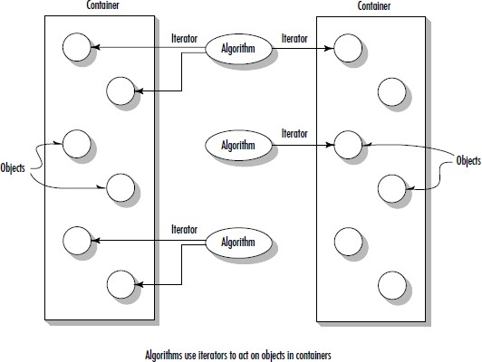
The Standard Template Library
Lecture 9 - 4
₁st
June, 2021

Slide 27
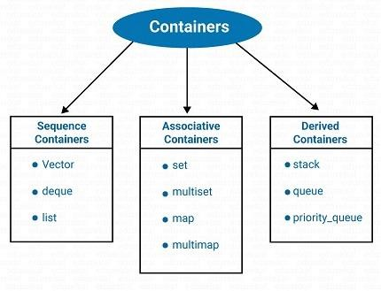
The Container
A container is a way to store data, whether the data consists of built-in types such as int and float, or class objects. For example array.
The STL containers are implemented by template classes, so they can be easily customized to hold different kinds of data.
Containers help us to implement and replicate simple and complex data structures very easily like arrays, list, vector, associative arrays and many more.
Lecture 9 - 5
₁st
June, 2021

Slide 28
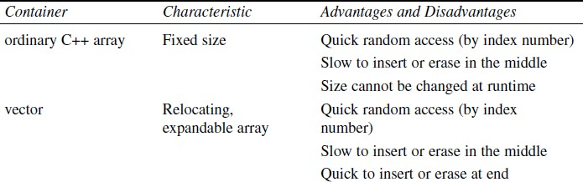
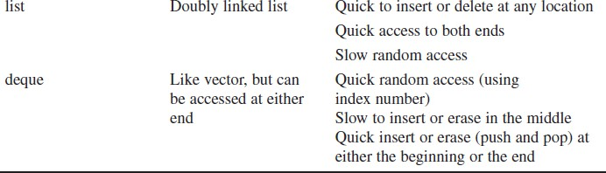
Sequence Containers
Sequence container stores a set of elements in what you can visualize as a line, like houses on a street.
Each element is related to the other elements by its position along the line.
An ordinary C++ array is an example of a sequence container.
Instantiating an STL container
object is easy. vector<int> aVect; or
list<airtime> departure_list;
Lecture 9 - 6
₁st
June, 2021

Slide 29
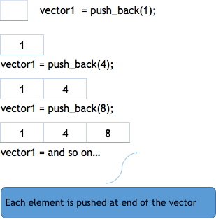
Vectors
Vectors as smart arrays. They manage storage allocation for you, expanding and contracting the size of the vector as you insert or erase data.
Vectors are same as dynamic arrays with the ability to resize itself automatically when an element is inserted or deleted, with their storage being handled automatically by the container.
You can use vectors much like arrays, accessing elements with the
[] operator. Such random access is very fast with vectors.
It’s also fast to add (or push) a new data item onto the end (the back) of the vector. When this happens, the vector’s size is automatically increased to hold the new item.
Lecture 9 - 7
₁st
June, 2021

Slide 30
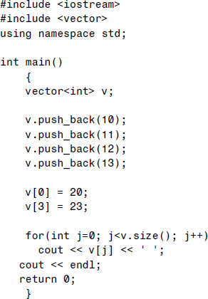
Vectors
The push_back() member function inserts the value of its argument at the back of the vector. The front of a vector (the element with index 0), cannot be used for inserting new elements. Here we push the values 10, 11, 12, and 13, so that v[0] contains 10, v[1] contains
11, v[2] contains 12, and v[3] contains 13.
The size() member function returns the number of
elements currently in the container, which in VECTOR is 4.
Lecture 9 - 8
₁st
June, 2021

Slide 31
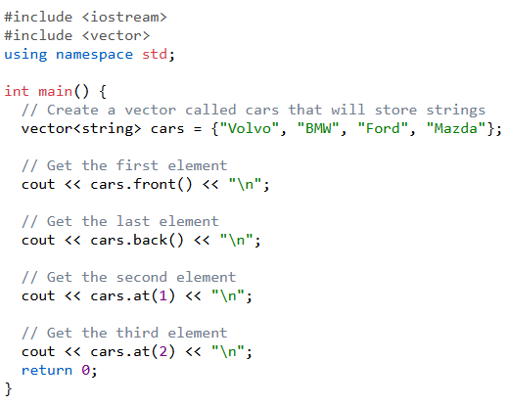
Vectors
One advantage of using the vector library, is that it includes many useful functions. For example, you can access the first or the last element of a vector with the .front() and
.back() functions:
To access an element at a specified index, you can use the .at() function and specify the index number:

Slide 32
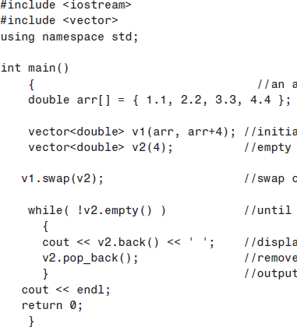
Vectors
The first vector v1 initializes with the values of a normal array passed to it as an argument. The arguments to this constructor are pointers to the start of the array and to the element one past the end.
The swap() member function exchanges all the data in one vector with all the data in another, keeping the elements in the same order.
The back() member function returns the value of the
last element in the vector.
The pop_back() member function removes the last
element in the vector.
The .empty() function returns 1 (true) if the vector is empty and 0 (false) if it contains one or more elements:
Lecture 9 - 9
₁st
June, 2021

Slide 33
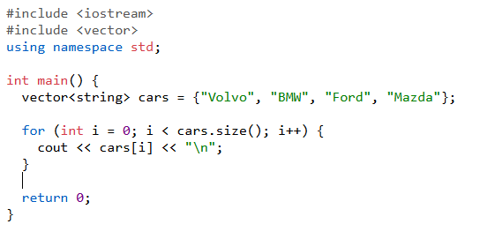
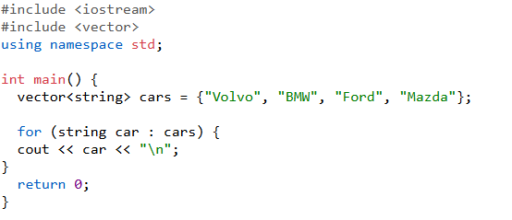
Vectors: Loop Through a Vector
You can loop through the vector elements by using a for loop combined with the .size() function:
You can also use a for-each loop (introduced in C++ version 11 (2011), which is cleaner and more readable:

Slide 34







Vectors
The insert() and erase() member functions insert or remove an element from an arbitrary location in a container.
These functions aren’t very efficient with vectors, since all the elements above the insertion or erasure must be moved to make space for the new element or close up the space where the erased item was.
The insert() member function takes two arguments: the place where an element will be inserted in a container, and the value of the element.
The erase() member function removes the element
at the specified location. erase(itr_start, itr_end).
₁st
June, 2021

Slide 35
Vectors
The insert() and erase() member functions insert or remove an element from an arbitrary location in a container.
These functions aren’t very efficient with vectors, since all the elements above the insertion or erasure must be moved to make space for the new element or close up the space where the erased item was.
The insert() member function takes two arguments: the place where an element will be inserted in a container, and the value of the element.
The erase() member function removes the element
at the specified location. erase(itr_start, itr_end).
₁st
June, 2021

Slide 36
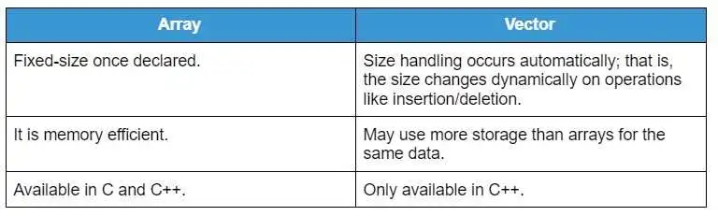
Vectors Vs Arrays

Slide 37


Lists
Lists are sequence containers that allow non-
contiguous memory allocation. As compared to vector, list has slow traversal, but once a position has been found, insertion and deletion are quick.
An STL list container is a doubly linked list, in which each element contains a pointer not only to the next element but also to the preceding one.
#include <iostream>
#include <list>
using namespace std;
int main()
{
list<int> list; list<int> list2{1,2,3};
}
A list is similar to a vector in that it can store multiple elements of the same type and dynamically grow in size.
₁st
June, 2021

Slide 38
Lists
#include <iostream>
#include <list>
To create a list, use the list keyword, and specify the type of values it should store within angle brackets <> and then the name of the list, like: list<type> listName.
using namespace std;
int main()
{
list<int> list; list<int> list2{1,2,3};
}
N.B: The type of the list cannot be changed after its been declared.
₁st
June, 2021

Slide 39
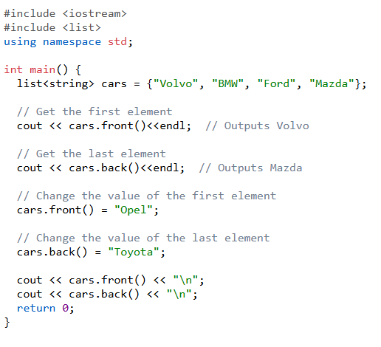
Lists
You cannot access list elements by referring to index numbers, like with arrays and vectors.
However, you can access the first or the last element with the .front() and .back() functions, respectively:
But change the value of the first or the last element with the .front() and .back() functions
₁st
June, 2021

Slide 40
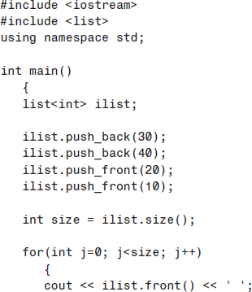

Lists
The push_front(), pop_front(), and front() member functions are similar to push_back(), pop_back(), and back(), which we’ve already seen at work with vectors.
The insert() function works similarly as vectors.
Note that you can’t use random access for list elements. For this reason the [] operator is not defined for lists.
We push data on the back (the end) and front of the list in such a way that when we display and remove the data from the front it’s in normal order:
10 20 30 40
₁st
June, 2021

Slide 41
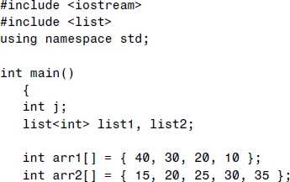
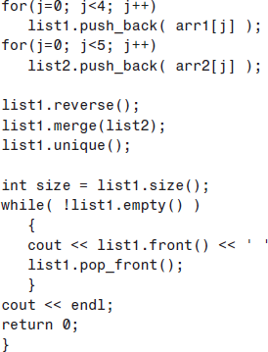
Lists
The first list is in backward order, so we return it to normal sorted order using the reverse() member function. List1 : 10, 20, 30, 40
The merge() function merges list2 into list1, keeping everything sorted and expanding list1 to hold the new items. The resulting content of list1 is 10, 15, 20, 20, 25, 30, 30, 35, 40
The unique() member function finds adjacent elements with the same value, and removes all but the first. The contents of list1 are then 10, 15, 20, 25, 30, 35, 40
₁st
June, 2021

Slide 42

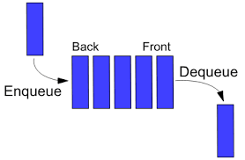
QUEUE
A queue stores multiple elements in a specific order, called FIFO.
FIFO stands for First in, First Out. To visualize FIFO, think of a queue as people standing in line in a ATM. The first person to stand in line is also the first who can pay and leave the ATM. This way of organizing elements is called FIFO in computer science and programming.
Unlike vectors, elements in the queue are not accessed by index numbers. Since queue elements are added at the end and removed from the front, you can only access an element at the front or the back.

Slide 43
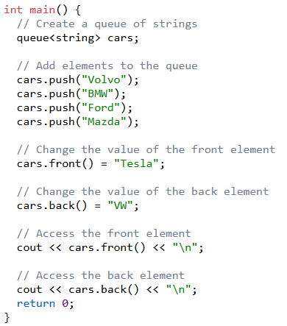
QUEUE
To create a queue, use the queue keyword, and specify the type of values. It should store within angle brackets <> and then the name of the queue, like: queue<type> queueName.
To add elements to the queue, you can use the .push() function after declaring the queue. The .push() function adds an element at the end of the queue:
In a queue, you can only access the element at the front or the back, using .front() and .back() respectively:
You can also use .front and .back to change the value of the front and back elements:
Note: The type of the queue cannot be changed after its been declared.
Note: You cannot add elements to the queue at the time of declaration, like you can with vectors.

Slide 44
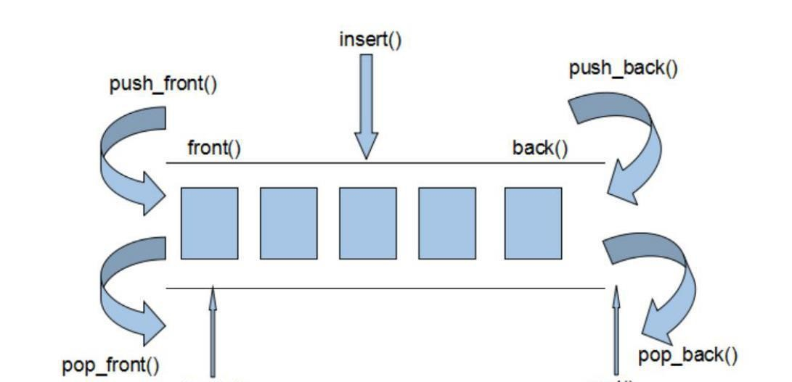
Deques
The third sequence container is the deque, which can be thought of as a combination of a stack and a queue.
A stack, works on a last-in-first-out principle. Both input and output take place on the top of the stack. A queue, on the other hand, uses a first-in-first-out arrangement: data goes in at the front and comes out at the back, like a line of customers in a bank.
A deque combines these approaches so you can insert or delete data from either end.
The word deque is derived from Double-Ended QUEue.
It’s a versatile mechanism that’s not only useful in its own right, but can be used as the basis for stacks and queues.
₁st
June, 2021

Slide 45
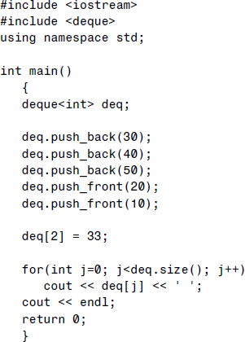
Deques
The push_back(), push_front(), and operator [] work the same for deques as for other containers.
The insert(),
empty(),
pop_back() and pop_front()
size(),
swap(),
functions
work
same as for other containers.
To access an element at a specified index, you can use the .at() function and specify the index number:
The .at() function is often preferred over square brackets [] because it throws an error message if the element is out of range:
₁st
June, 2021

Slide 46
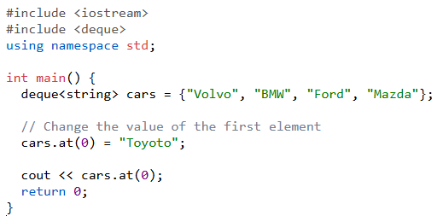
Deques
To change the value of a specific element, you can refer to the index number. However, it is safer to use the .at() function:

Slide 47
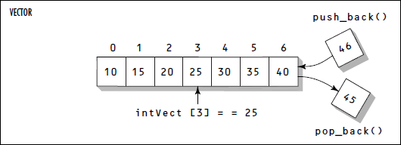
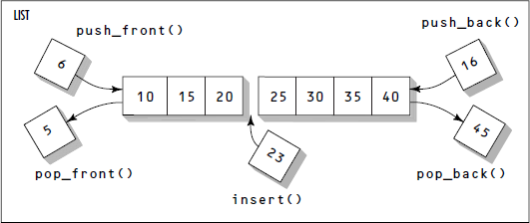
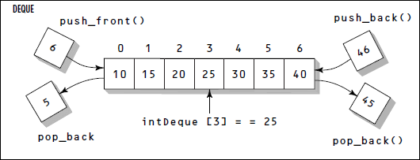
Sequence containers
₁st
June, 2021

Slide 48
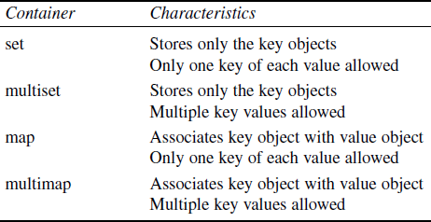
Associative Containers
Associative container is not sequential; instead it uses keys to access data.
The keys, typically numbers or strings, are used automatically by the container to arrange the stored elements in a specific order.
There are two kinds of associative containers in the STL: sets
and maps.
A set stores a number of items which contain keys. The keys are the attributes used to order the items. For example, a set might store objects of the person class, their name attributes as keys.
A map stores pairs of objects: a key object and a value object. A map is like an array, you access items with indices that can be of an arbitrary type. That is, the key object serves as the index, and the value object is the value at that index.
₁st
June, 2021

Slide 49
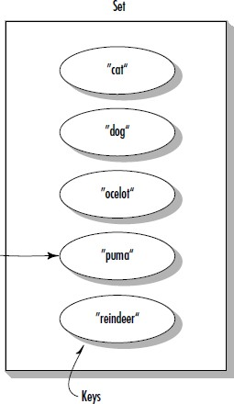
Sets
Sets are often used to hold objects of user-defined classes such as employees in a database.
However, sets can also hold simpler elements such as strings.
The objects are arranged in order, and the entire object is the key as the members are string. Sorted automatically in ascending order.
Each element has to be unique, because the value of the element identifies it. This meaning is equal or duplicate values are ignored
The value of the element cannot be modified once it is added to the set, though it is possible to remove and add the modified value of that element.
Cannot be accessed by index numbers, because the order is based on sorting and not indexing.
₁st
June, 2021

Slide 50
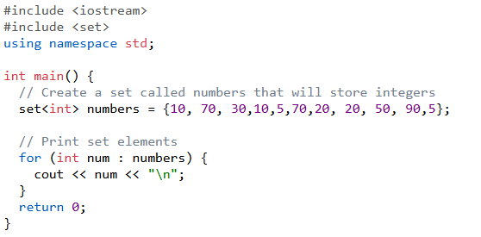

SET
Elements in a set are unique, which means they cannot be duplicated or equal.

Slide 51
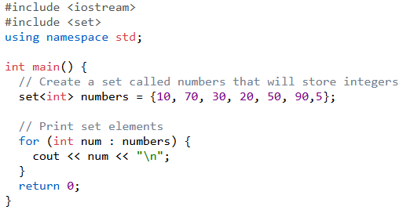

SET
Output

Slide 52
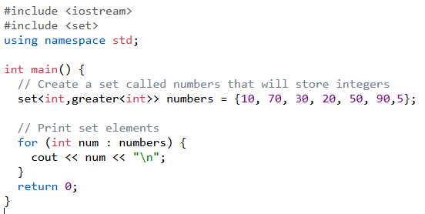
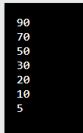
SET
Output
By default, the elements in a set are sorted in ascending order. If you want to reverse the order, you can use the greater<type> functor inside the angle brackets, like this:

Slide 53
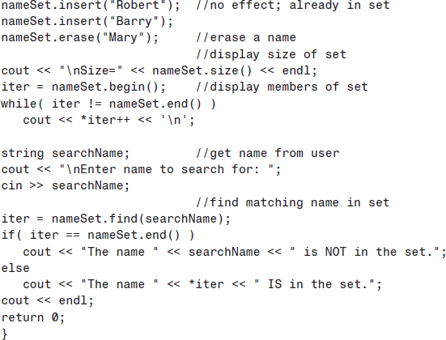
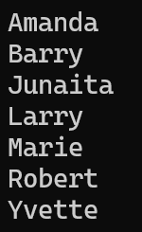
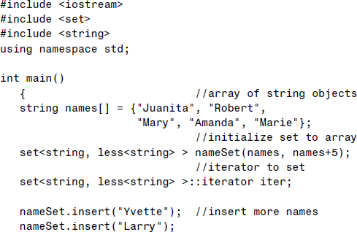
Sets
To add elements to a set, you can use the .insert()
To remove specific elements from a set, you can use the .erase() function function.
To remove all elements from a set, you can use the .clear() function:
₁st
June, 2021

Slide 54
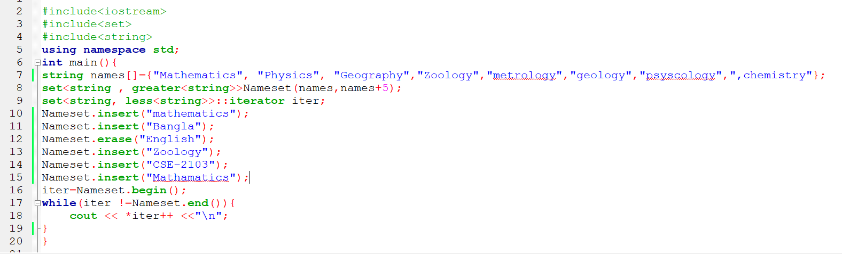
Spot Test

Slide 55
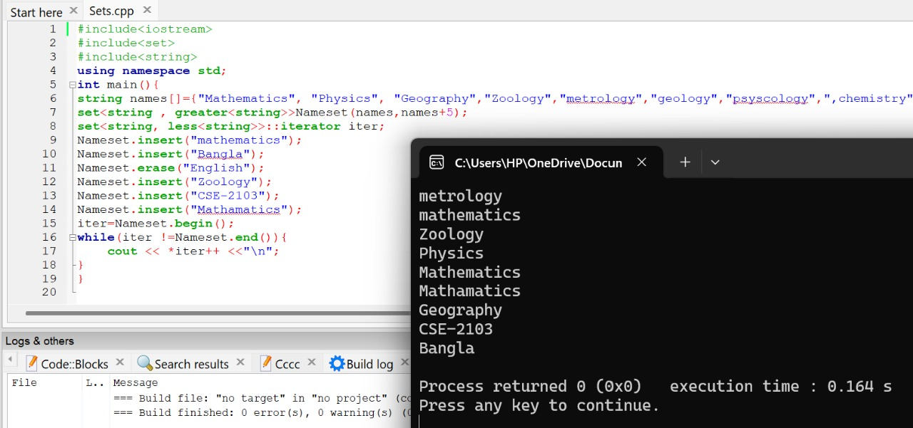
Spot Test Result

Slide 56
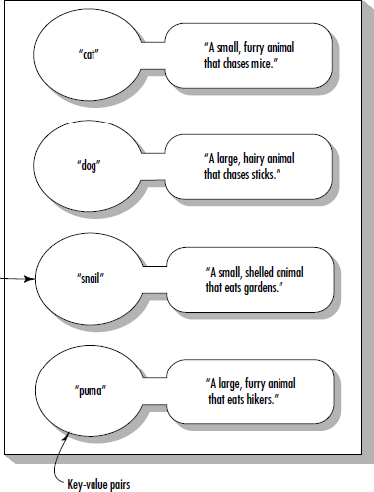
Maps
A map stores pairs. A pair consists of a key object and
a value object.
The key object contains a key that will be searched for. The value object contains additional data.
The key objects can be strings, numbers, or objects of
more complex classes.
The values are often strings or numbers, but they can also be objects or even containers.
For example, the key could be a word, and the value could be a number representing how many times that word appears in a document. Such a map constitutes a frequency table.
Each key has to be unique.
₁st
June, 2021

Slide 57

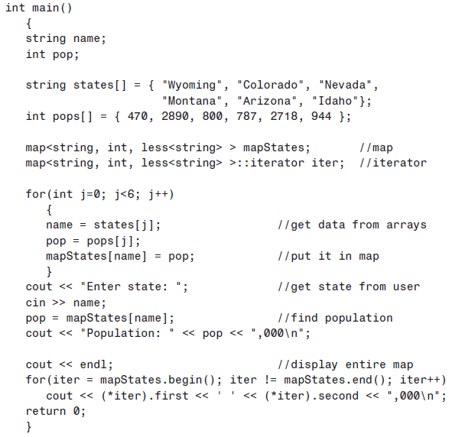

Maps
The definition of a map takes three template
arguments:
map<string, int, less<string> > maStates;
The first is the type of the key. In this case it’s
string, representing the state name.
The second is the type of the value; in this case it’s int, which represents the population, in 1,000s.
The third argument specifies the ordering that will be used for the keys. We choose to have it ordered alphabetically by the names of the states; that’s what less<string> does.
₁st
June, 2021

Slide 58
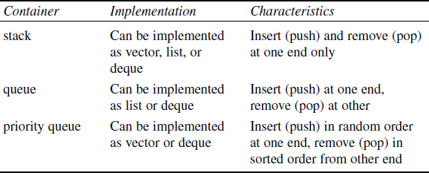
Container Adapters
It’s possible to create special-purpose containers from the normal containers mentioned previously using a construct called container adapters. These special-purpose containers have simpler interfaces than the more general containers.
The specialized containers implemented with container adapters in the STL are stacks, queues, and priority queues.
We use a template within a template to instantiate these classes. For example, here’s a stack
object instantiated from the deque class:
stack< deque<int> > aStak; stack<deque<int>> astak; //syntax error because the compiler will interpret the
>> as an operator.
₁st
June, 2021

Slide 59
Algorithms
Algorithms in the STL are procedures that are applied to containers to process their data in
various ways.
For example, there are algorithms to sort, copy, search, and merge data.
Algorithms are represented by template functions.
An algorithm is a function that does something to the items in a container (or containers).
Algorithms in the STL are not member functions or even friends of container classes, they are standalone template functions.
You can use them with built-in C++ arrays, or with container classes you create yourself.
The specialized containers implemented with container adapters in the STL are stacks, queues,
and priority queues.
₁st
June, 2021

Slide 60
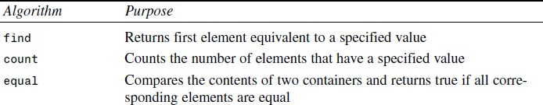
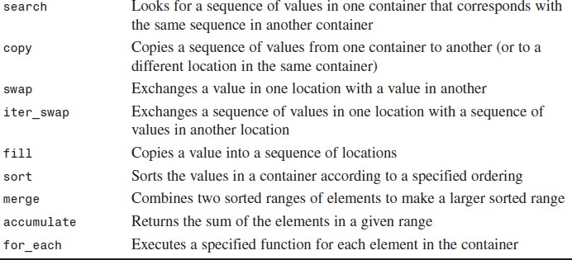
Algorithms
Some Typical STL Algorithms
₁st
June, 2021

Slide 61

The find() Algorithm
The find() algorithm looks for the first element in a container that has a specified value.
Returns an iterator to the first element that compares equal to val. If no such element is found, the
function returns last.
find(InputIterator first, InputIterator last, const val)
#include <iostream> #include <algorithm> #include <vector> Using namespace std; int main () {
// std::cout
// std::find
// std::vector
vector<int> myvector (myints,myints+4); vector<int>::iterator it;
it = find (myvector.begin(), myvector.end(), 30); if (it != myvector.end())
cout << "Element " << ser <<" found at position : "
<< it - vec.begin() << " (counting from zero) \n" ;
else
cout << "Element not found in myvector\n";
Omar Faruque
Lecture^{re}9^{tur}-^{n 0}2;5 1st June, 2021
}

Slide 62

The count() Algorithm
The count() algorithm counts how many elements in a container have a specified value and
returns this number.
count(InputIterator first, InputIterator last, const val)
₁st
June, 2021

Slide 63
The sort() Algorithm
The sort() algorithm Sorts the elements in the range [first,last) into ascending order (by default).
sort(InputIterator first, InputIterator last)
#include <iostream> #include <algorithm> using namespace std;
int arr[] = {45, 2, 22, -17, 0, -30, 25, 55};
int main()
{
sort(arr, arr+8); for(int j=0; j<8; j++)
cout << arr[j] << ‘ ‘;
cout << endl; return 0;
}
Output: -30, -17, 0, 2, 22, 25, 45, 55
#include <iostream> #include <algorithm> using namespace std;
int arr[] = { 1, 5, 8, 9, 6, 7, 3, 4, 2, 0 };
int main()
{
sort(arr, arr+10, greater<int>() ); for(int j=0; j<10; j++)
cout << arr[j] << ‘ ‘;
cout << endl; return 0;
}
Output: 9 8 7 6 5 4 3 2 1 0
₁st
June, 2021

Slide 64


The search() Algorithm
The search() algorithm looks for a sequence of values, specified by one container, within another
container.
search(Iterator1 first1, Iterator1 last1, Iterator2 first2, Iterator2 last2);
Searches the range [first1,last1) for the first occurrence of the sequence defined by [first2,last2), and returns an iterator to its first element, or last1 if no occurrences are found.
In this program code, the algorithm looks for the sequence 11, 22, 33, specified by the array pattern, within the array source.
The output is: Match at 3
₁st
June, 2021

Slide 65

The merge() Algorithm
The merge() algorithm is used to merge the elements from two source containers into a
destination container.
merge (initer1 beg1, initer1 end1,initer2 beg2, initer2 end2, outiter res)
The output looks like this:
1 2 3 3 4 5 6 8
As you can see, merging preserves the ordering, gathering the two sequences of source elements into the destination container.
₁st
June, 2021

Slide 66



The for_each() Algorithm
The for_each() algorithm allows you to do something to every item in a container.
You write your own function to determine what that “something” is.
Your function can’t change the elements in the container, but it can use or display their values.
for_each (InputIterator first, InputIterator last, Function fn);
transform(inches, inches+5, centi, in_to_cm);
Here’s an example in which for_each() is used to convert all the values of an array from inches to
centimeters and display them.
The output looks like this:
8.89 15.748 2.54 32.385 10.9982
₁st
June, 2021

Slide 67
Iterators
Iterators are pointer-like entities that are used to access individual data items, which are usually called elements in a container.
Often they are used to move sequentially from element to element, a process called iterating
through the container.
You can increment iterators with the ++ operator so they point to the next element, and dereference them with the * operator to obtain the value of the element they point to.
In the STL an iterator is represented by an object of an iterator class.
There are three major classes of iterators: forward, bidirectional, and random access.
A forward iterator : only move forward, one item at a time, use ++ operator, can’t move backward and it can’t be set to an arbitrary location in the middle of the container.
A bidirectional iterator : can move backward as well as forward, use both its ++ and -- operators.
A random access iterator : in addition to moving backward and forward, can jump to an arbitrary location.
₁st
June, 2021

Slide 68


Iterators as Smart Pointers
When you define an iterator you must specify what kind of container it will be used for.
For example, if you’ve defined a list holding elements of type int list<int> iList; //list of ints
Then to define an iterator to this list you
say
list<int>::iterator iter; //iterator to list-of-ints
When you do this, the STL automatically makes this iterator a bidirectional iterator, because that’s what a list requires. An iterator to a vector or a deque is automatically created as a random-access iterator.
₁st
June, 2021

Slide 69
CSE-2103
Object Oriented Programming
Lecture 8 - 1
₂₅th
May, 2021

Slide 70
Streams and Files
Lecture 8 - 2
₂₅th
May, 2021

Slide 71

Stream Classes
In C++ code, generally the flow of data is called as stream.
Stream is represented by an object of a particular class. Different streams are used to represent different kinds of data flow.
For example, the ifstream class represents
data flow from input disk files.
The extraction operator >> is a member of the istream class,
The insertion operator << is a member of the
ostream class.
The cout is a predefined object of the
ostream_withassign class.
Similarly, cin is an
object of the
istream_withassign class.
Lecture 8 - 3
₂₅th
May, 2021

Slide 72

The ios Class
The ios class is the granddaddy of all the stream classes, and contains the majority of the features you need to operate C++ streams.
The three most important features are the formatting flags, the error- status flags, and the file operation mode.
Formatting Flags
Formatting flags are a set of enum definitions in ios class.
They act as on/off switches that specify choices for various aspects of input and output format and operation.
Lecture 8 - 4
₂₅th
May, 2021

Slide 73

The ios Class
Manipulators
Manipulators are formatting instructions inserted directly into a stream.
We’ve seen examples before, such as
the manipulator endl,
cout << “The Maniputars.” << endl;
cout << hex << var;
Lecture 8 - 5
₂₅th
May, 2021

Slide 74

The ios Class
Manipulators with Arguments
Manipulators are formatting instructions inserted directly into a stream.
Manipulators affect only the data that follows them in the stream, not the data that precedes them.
cout << setw(20) << var;
ch
Lecture 8 - 6
₂₅th
May, 2021

Slide 75


The istream Class
Lecture 8 - 7
₂₅th
May, 2021

Slide 76


The ostream Class
Lecture 8 - 8
₂₅th
May, 2021

Slide 77


Stream Errors
Error-Status Bits:
In C programming:
We can check input error by the return value of scanf() function like this:
if(scanf("%d %d %d ,&a, &b, &c)) == 3)
{
// write code
}
else
{
// error
}
Lecture 8 - 9
₂₅th
May, 2021

Slide 78

Stream Errors
Error-Status Bits:
₂₅th
May, 2021

Slide 79
Stream Errors
Error-Status Bits:
while(true)
{
cout << “\nEnter an integer: “;
cin >> i;
if( cin.good() ) // if no errors
{
break; // exit loop
}
cin.clear(); // clear the error bits cout << “Incorrect input”;
}
cout << “integer is “ << i;
₂₅th
May, 2021

Slide 80
File I/O
Working with disk files requires another set of classes:
ifstream for input,
ofstream for output, and
fstream for both input and output.
Objects of these classes can be associated with disk files, and we can use their member functions to read and write to the files.
To use file I/O in C++ you typically include the iostream and fstream header files: #include <iostream>
#include <fstream>
We will declare variables of the ofstream and ifstream classes to get output and input file streams.
Opening the file is done automatically by the stream's constructor. The constructor takes a filename and an indication of whether the stream is an input or output stream.
ifstream infile("mydata.txt",ios::in);
₂₅th
May, 2021

Slide 81


File I/O
The Mode Bits
₂₅th
May, 2021

Slide 82

Writing Data to a File
Formatted I/O:
In formatted I/O, numbers are stored on disk as a series of characters. Thus 6.02, rather than being stored as a 4-byte type float or an 8-byte type double, is stored as the characters ‘6’, ‘.’, ‘0’, and ‘2’.
Characters and strings are stored more or less normally.
The following program writes a character, an integer, a type double, and two string objects to a disk file.
₂₅th
May, 2021

Slide 83

Reading Data from a File
We can read the file by using an ifstream object, initialized to the name of the file.
The file is automatically opened when the object is created.
We can then read from it using the
extraction (>>) operator.
₂₅th
May, 2021

Slide 84


Strings with Embedded Blanks in File I/O
The technique of our last examples won’t work with char* strings containing embedded blanks.
To handle such strings, you need to write a specific delimiter character after each string, and use the getline()function. This function reads characters, including whitespace, until it encounters the ‘\n’ character, and places the resulting string in the buffer supplied as an argument.
₂₅th
May, 2021

Slide 85



Character I/O in File
The put() and get() functions, respectively, can be used to output and input single characters.
These are members of ostream and istream class.
₂₅th
May, 2021

Slide 86
Binary I/O
You can write a few numbers to disk using formatted I/O, but if you’re storing a large amount of numerical data it’s more efficient to use binary I/O, in which numbers are stored as they are in the computer’s RAM memory, rather than as strings of characters.
In binary I/O an int is stored in 4 bytes, whereas its text version might be “12345”, requiring 5 bytes. Similarly, a float is always stored in 4 bytes, while its formatted version might be “6.02314e13”, requiring 10 bytes.
We use two new functions: write(), a member of ofstream; and read(), a member of ifstream.
These functions think about data in terms of bytes (type char). They don’t care how the data is
formatted, they simply transfer a buffer full of bytes from and to a disk file.
os.write( reinterpret_cast<char*>(buff), MAX*sizeof(int) );
The parameters to write() and read() are the address of the data buffer and its length.
The address must be cast, using reinterpret_cast, to type char*, and the length is the length in
bytes (characters), not the number of data items in the buffer.
₂₅th
May, 2021

Slide 87

Binary I/O
Here both the output stream and the input stream are associated with the same file, the first stream must be closed before the second is opened.
We use the close() member
function for this.
₂₅th
May, 2021

Slide 88


Object I/O
Writing an Object to Disk:
When writing an object, we generally use the binary mode.
This writes the same bit configuration to disk that was stored in memory, and ensures that numerical data contained in objects is handled properly.
The contents of the pers object are then written to disk, using the write() function.
We use the sizeof operator to find the length of the pers object.
₂₅th
May, 2021

Slide 89

Object I/O
Reading an Object from Disk:
The contents of the person object are read from disk, using the read() member function.
₂₅th
May, 2021

Slide 90



Multiple Objects I/O
₂₅th
May, 2021

Slide 91


File Pointers
The seekg() function allow you to set the pointer.
The seekg() function can be used in two ways.
file.seekg(0);
The single argument represents the position from the start of the file.
seekg(-10, ios::end);
The two arguments, where the first argument represents an offset from a particular location in the file, and the second specifies the location from which the offset is measured.
There are three possibilities for the second argument:
beg - is the beginning of the file,
cur - is the current pointer position, and
end - is the end of the file.
₂₅th
May, 2021

Slide 92
File Pointers
The tellg() function returns the current position of
the get pointer.
int endposition = infile.tellg();
₂₅th
May, 2021

Slide 93


Reacting to Errors
₂₅th
May, 2021

